Slide 1
FORENSIC AUDIT AI
Know what is true
before you commit.
Product concept and fictional walkthrough for evidence-led due diligence.
VERIFIED
UNVERIFIED
CONTRADICTED
AI reads the record. Humans verify. The evidence decides.
DM AI LABS

Slide 2
THE PROBLEM
Most decisions start with a story — not a record.
A pitch deck, website and LinkedIn profile can be persuasive. The hard part is knowing which claims survive contact with evidence.
YOU HEAR
YOU NEED
YOU DECIDE
Founder. Profitable. Regulated. Successful exits.
Who said it? When? What document supports it?
Proceed, pause, add conditions — or escalate.
Forensic Audit AI is the first pass: fast enough to use early, disciplined enough to show you what still needs proving.

Slide 3
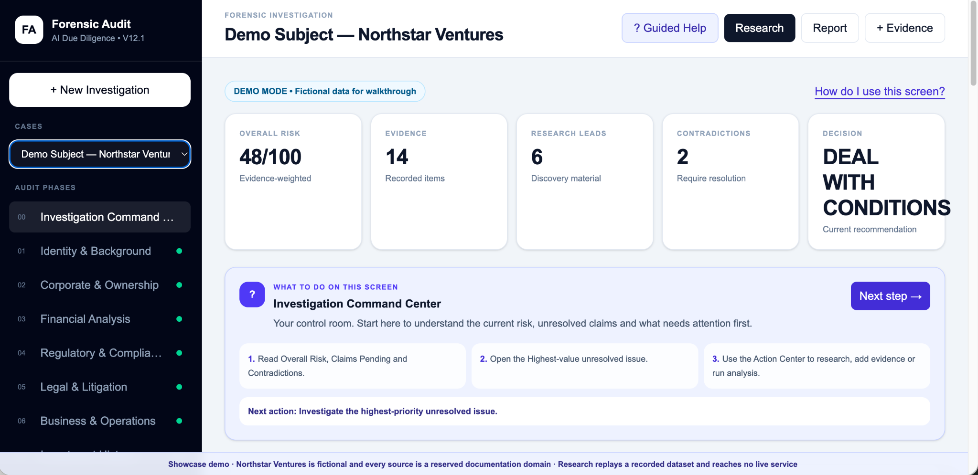
PRODUCT IN ONE SCREEN
A command center for evidence-led decisions.
Earlier application screenshot: 48/100. The public walkthrough starts at 40/100 with fictional data.
48 / 100 RISK
2 CONTRADICTIONS

Slide 4
THE OPERATING MODEL
Nothing becomes a fact just because AI found it.
Every item moves through a chain of custody. Unresolved claims stay unresolved.
01
02
03
04
05
RESEARCH
LEAD
EVIDENCE
VERIFY
VERDICT
→
→
→
→
Find relevant public-record material.
Discovery material — not evidence yet.
Bind a claim to a source and date.
Corroborate, contradict or leave open.
Weight what is actually established.
The refusal to advance an unsupported claim is a core product behavior.

Slide 5
AI INSIDE THE WORKFLOW
AI does the reading, structuring and comparison — not the final human verification.
Product workflow shown. The public demo uses fixed examples with no live AI or research calls.
1
Search & triage
2
Extract claims
Build focused research tasks across identity, ownership, finance, regulation, legal, reputation and more.
Turn source material into discrete propositions with source, date and status.
3
Compare evidence
4
Prioritize
Group related claims, detect corroboration and surface contradictions.
Rank unresolved issues by materiality and confidence so the investigator knows what to check next.

Slide 6
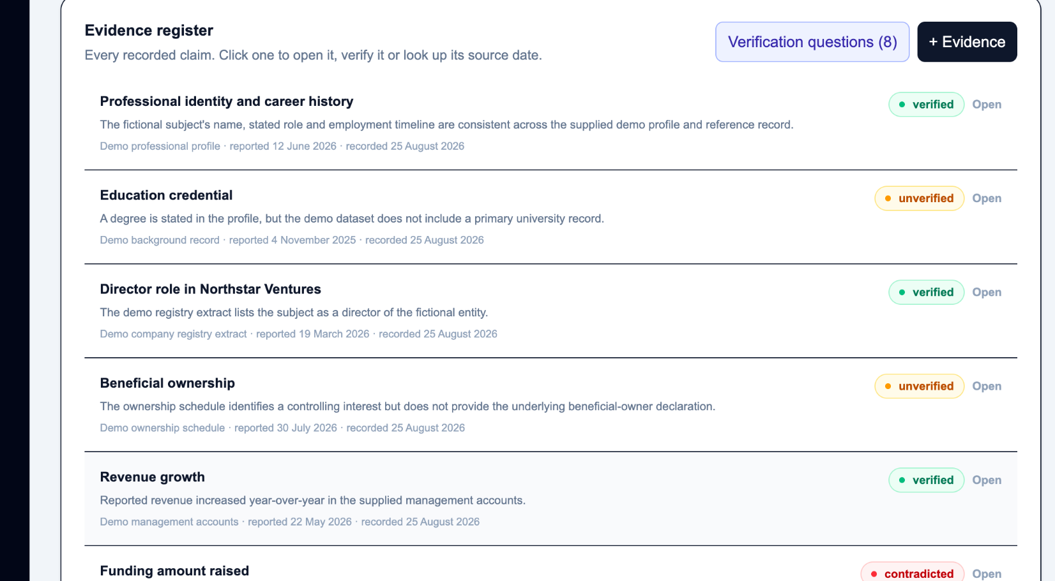
EVIDENCE REGISTER
Every claim has a visible state — verified, unverified or contradicted.
The register makes the audit inspectable instead of hiding the reasoning inside a summary paragraph.
WHAT THE INVESTIGATOR SEES
A precise claim, not a vague paragraph.
The source and the date it reported the claim.
A status the risk engine can actually read.
One click to open the item and inspect it.
verified
unverified
contradicted

Slide 7
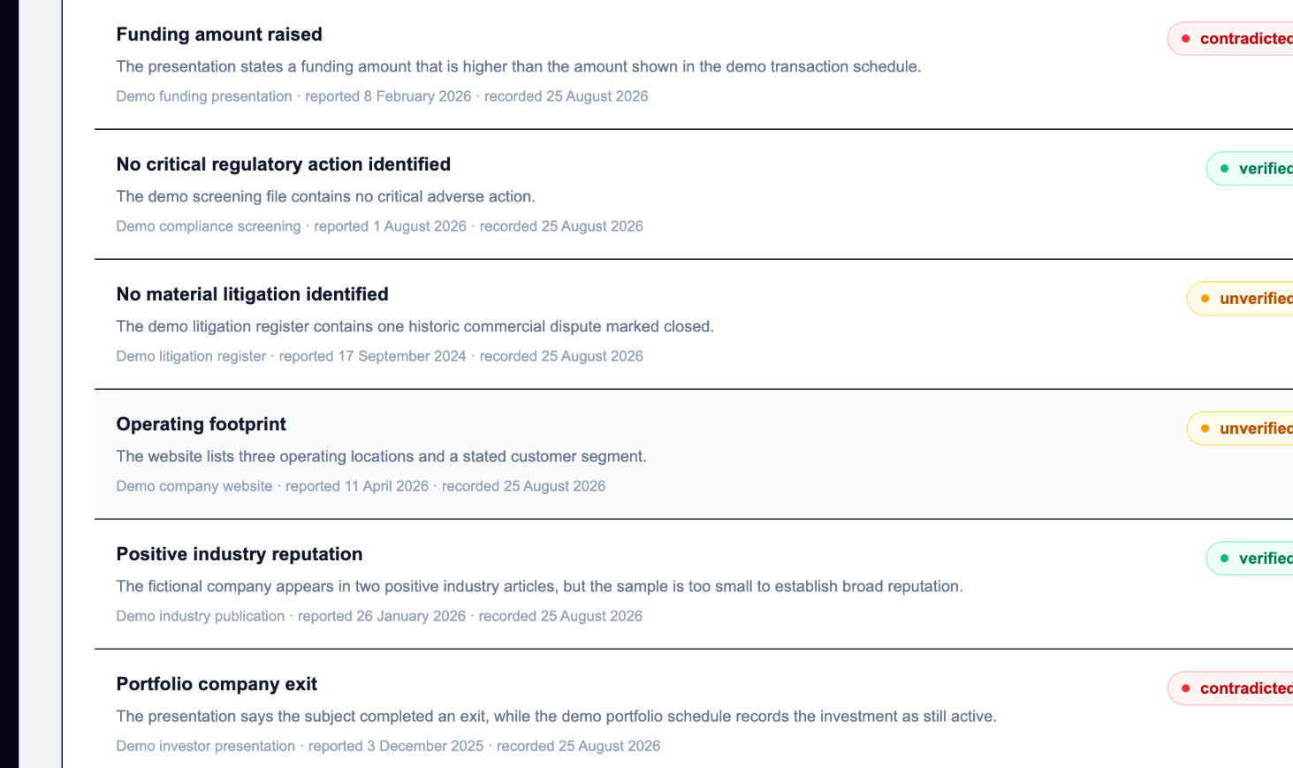
CONTRADICTION DETECTION
The red flag sits on the gap — not on the person.
AI compares related claims and highlights where the record does not reconcile. The investigator decides what the discrepancy means.
CONTRADICTED
Funding amount raised
The presentation states a higher amount than the transaction schedule.
Why this matters
No accusation is inferred.
The discrepancy remains visible.
The next action is to resolve it with a primary or independent source.

Slide 8
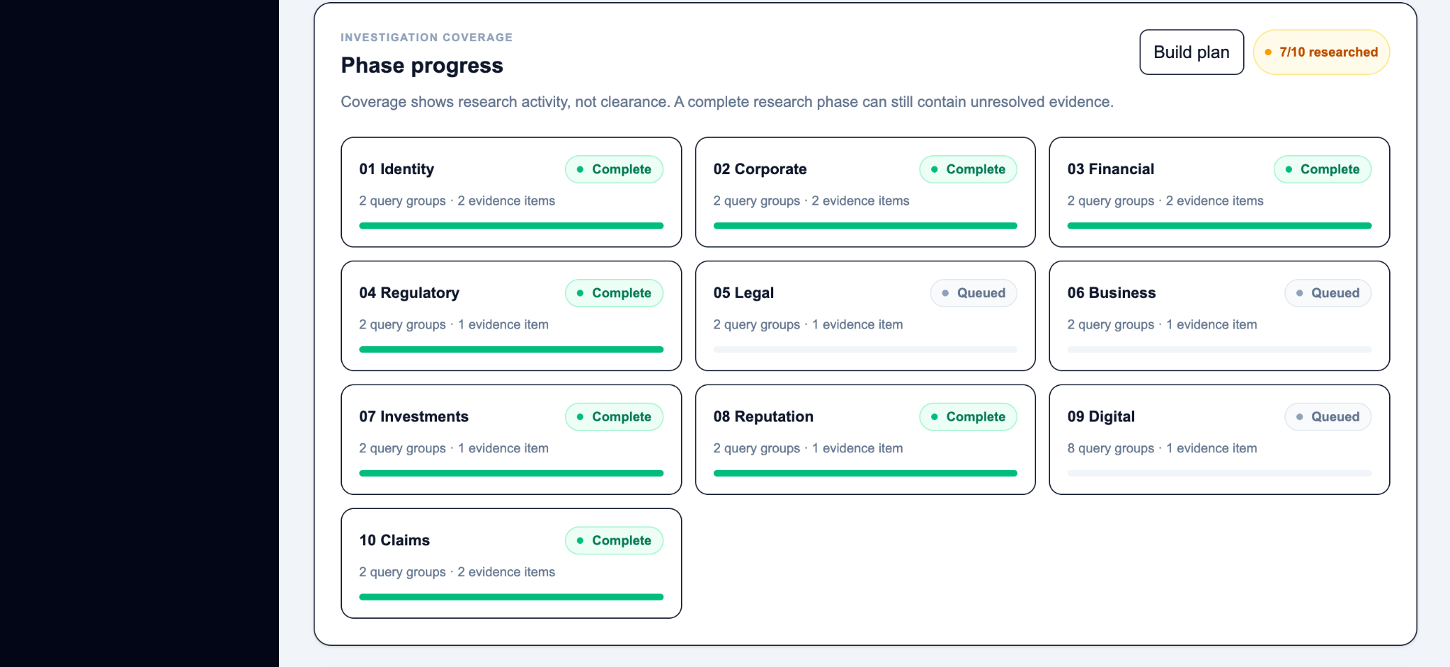
INVESTIGATION COVERAGE
Research is systematic — and incomplete work stays visible.
The phase tracker shows what has been researched without pretending that “complete research” means “cleared”.
7 / 10 RESEARCHED

Slide 9
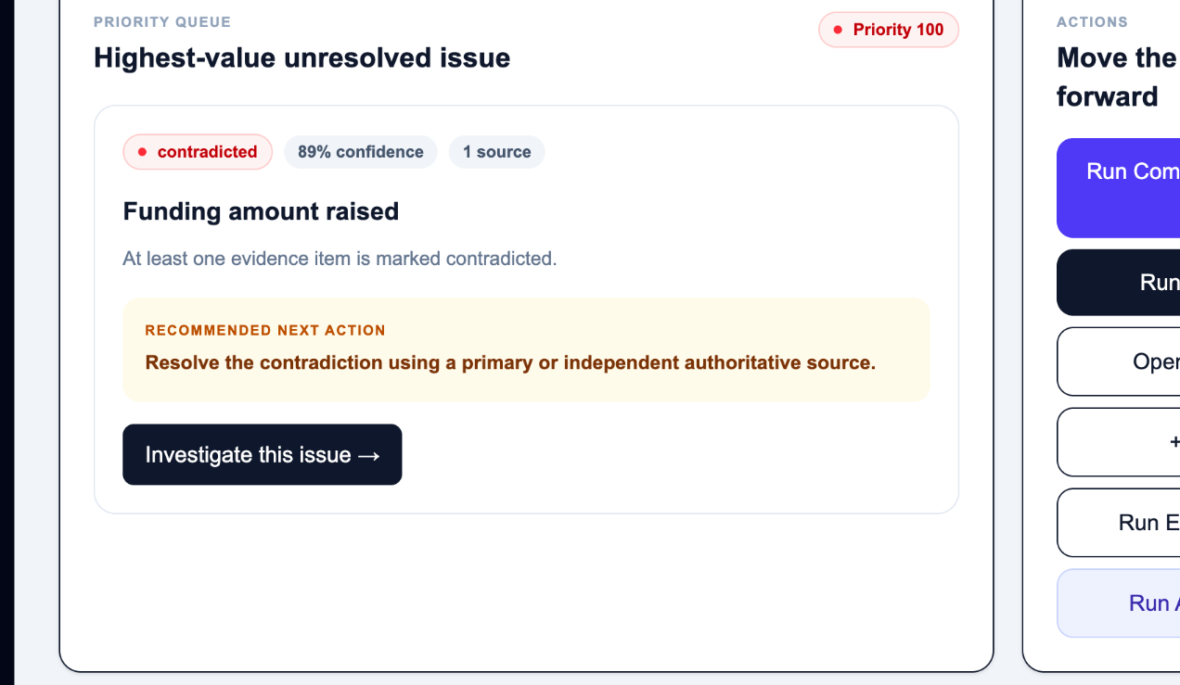
PRIORITY QUEUE
The system tells you what to investigate next.
Instead of drowning in dozens of findings, the command center surfaces the highest-value unresolved issue and the action most likely to close it.
FROM FINDING TO ACTION
Funding amount raised
Priority 100
Recommended next action
Resolve the contradiction using a primary or independent authoritative source.
This is where AI becomes useful: not by “deciding”, but by focusing human attention.

Slide 10
GUIDED INVESTIGATION
Built so a non-expert can follow the workflow.
Every screen explains what to read, what to do next and where the investigator should focus.
WHY GUIDED HELP MATTERS
Reduces training time.
Keeps the audit in the right sequence.
Makes “what next?” explicit.
Helps users distinguish research, evidence and verification.
A serious workflow should be easy to follow without making the reasoning simplistic.

Slide 11
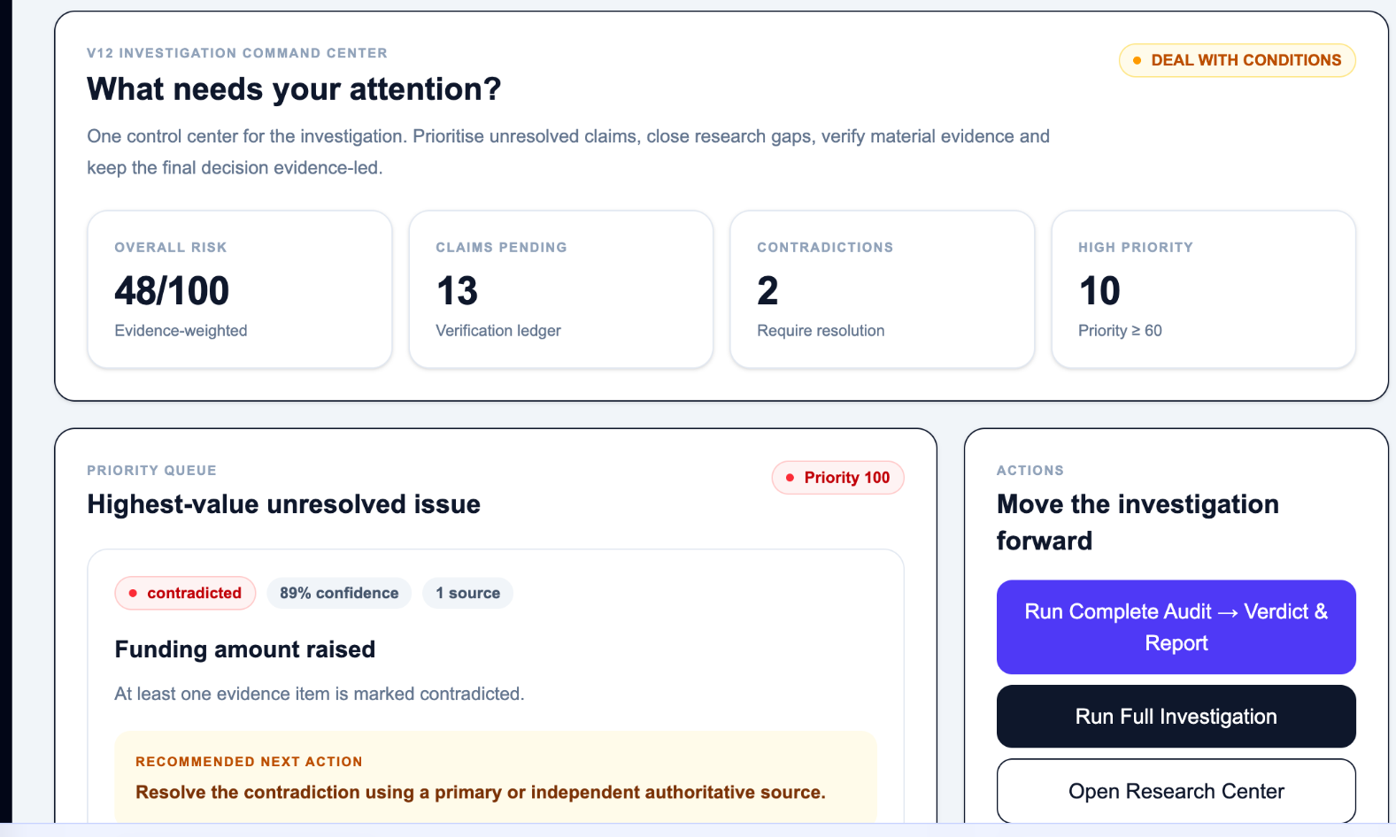
DYNAMIC VERDICT
Risk moves as evidence firms up.
Earlier application example shown. In the public walkthrough, evidence status changes update an illustrative score.
DEAL WITH CONDITIONS
48 / 100
Evidence-weighted risk
Verified findings carry more weight.
Unverified items are discounted, not ignored.
Contradictions stay visible until resolved.
Volume alone should not inflate risk.

Slide 12
TRUST IS A PRODUCT FEATURE
The system is designed to resist confident fiction.
These design principles keep sources visible and distinguish machine assessment from human verification.
No invented source
If a claim cannot be bound to a real retrieved source, it should not surface as evidence.
No guessed date
If the source does not state a date, the system should say so.
No false verification
Machine-assessed is not investigator-verified.
No silent deletion
Potential duplicates are flagged; material findings remain inspectable.
No certainty theater
“The first pass. Not the last word.”

Slide 13
WHERE IT FITS
A disciplined first pass before the expensive last mile.
Use it when the cost of being wrong is high — and before you decide whether a specialist diligence firm is justified.
INVEST
PARTNER
SIGN
Founder / fund / target diligence
Co-founder, JV or strategic partner
Vendor, counterparty or acquisition target
ACCEPT MONEY
LEND YOUR NAME
RENEW
Investor / funder background
Board, advisor or endorsement
Re-screen an existing relationship
Not a replacement for professional due diligence. A better way to know when you need it — and what to ask when you do.

Slide 14
FORENSIC AUDIT AI
It never pretends to be
more certain than it is.
The first pass. Not the last word.
Explore the fictional walkthrough at forensic.dmailabs.ai
DM AI LABS
Product concept • Fictional examples

