Slide 1


See It Work
Build a simple business tool with AI
Free recorded masterclass with Dheeraj Mehra
01
Notes:
Welcome to AI for Business. I’m Dheeraj Mehra, founder of DM AI Labs. This is a recorded session, so you can pause and revisit any part. Today we will look at three systems I have built, then work through a much smaller example together. The aim is to understand how you can take a task you already know, explain it clearly to AI, and check whether the result is useful. You do not need to begin with coding. You begin with the work.

Slide 2

A task worth improving
Which enquiry should sales act on first?
A familiar business question makes a useful starting point.
02
Notes:
Think about your working week. What do you prepare, check or write again and again? It might be a weekly report, a summary before a meeting, or a response after a customer conversation. Where do you spend time searching for information or deciding what to do? Write down three examples, then choose one you understand well. We are looking for a small, useful starting point. A first project does not need to run your whole business.

Slide 3
Three working systems
Growth Engine
HealthVault
AI Wealth OS
Product showcases, followed by a smaller sales build
03
Notes:
Before our small example, let’s see where this approach can lead. We have three existing demonstrations: Growth Engine, HealthVault and AI Wealth OS. These are product examples, rather than projects you are expected to reproduce today. Look at how each system organizes information and helps the user navigate a task. The demonstrations are evidence of the interfaces and workflows shown; they do not establish medical, investment or business outcomes. After watching them, we will come back to a simple sales lead qualification tool.

Slide 4
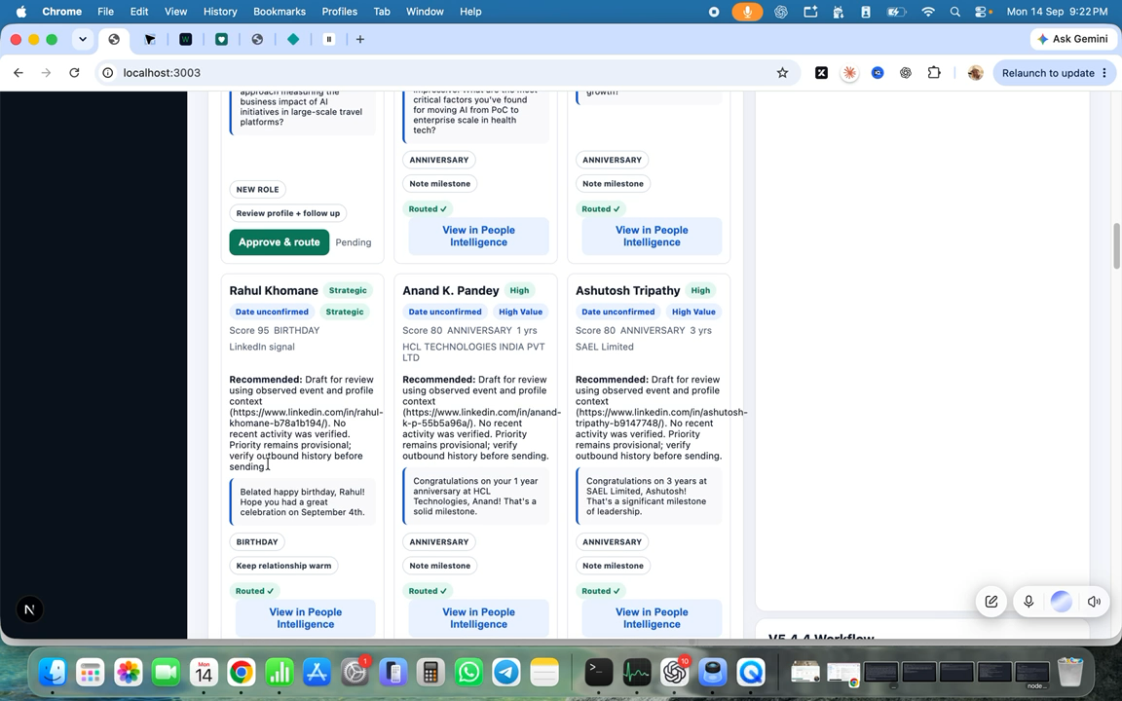
Growth Engine
Dheeraj and John review the working day
Briefing, relationship context and the Action Calendar
04
Notes:
In this recording, you will see two things together. First, a natural conversation with John, my AI assistant, as I review what needs attention. Second, the Growth Engine workflow: the daily briefing, relationship signals, LinkedIn history and the Action Calendar. Notice that reviewing a relationship involves context and judgment. A person remains responsible for outreach and the next action. Let’s watch the complete recording.

Slide 5
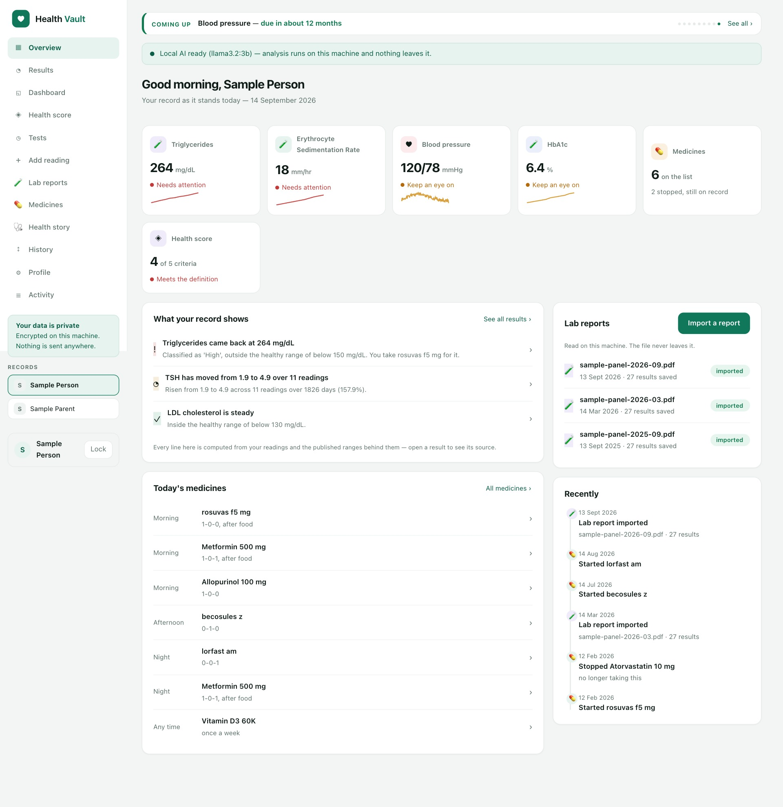
HealthVault
A product example that organizes health records
Observe the interface and workflow shown.
05
Notes:
Our next example is HealthVault. Watch the existing demonstration to see what the product shows and how the user moves through it. For this course, we are using the demonstration to illustrate how a system can organize information and interactions. We are not using it as medical advice or claiming clinical effectiveness. Your first course project will be a smaller workplace tool with a clear result that you can test.

Slide 6
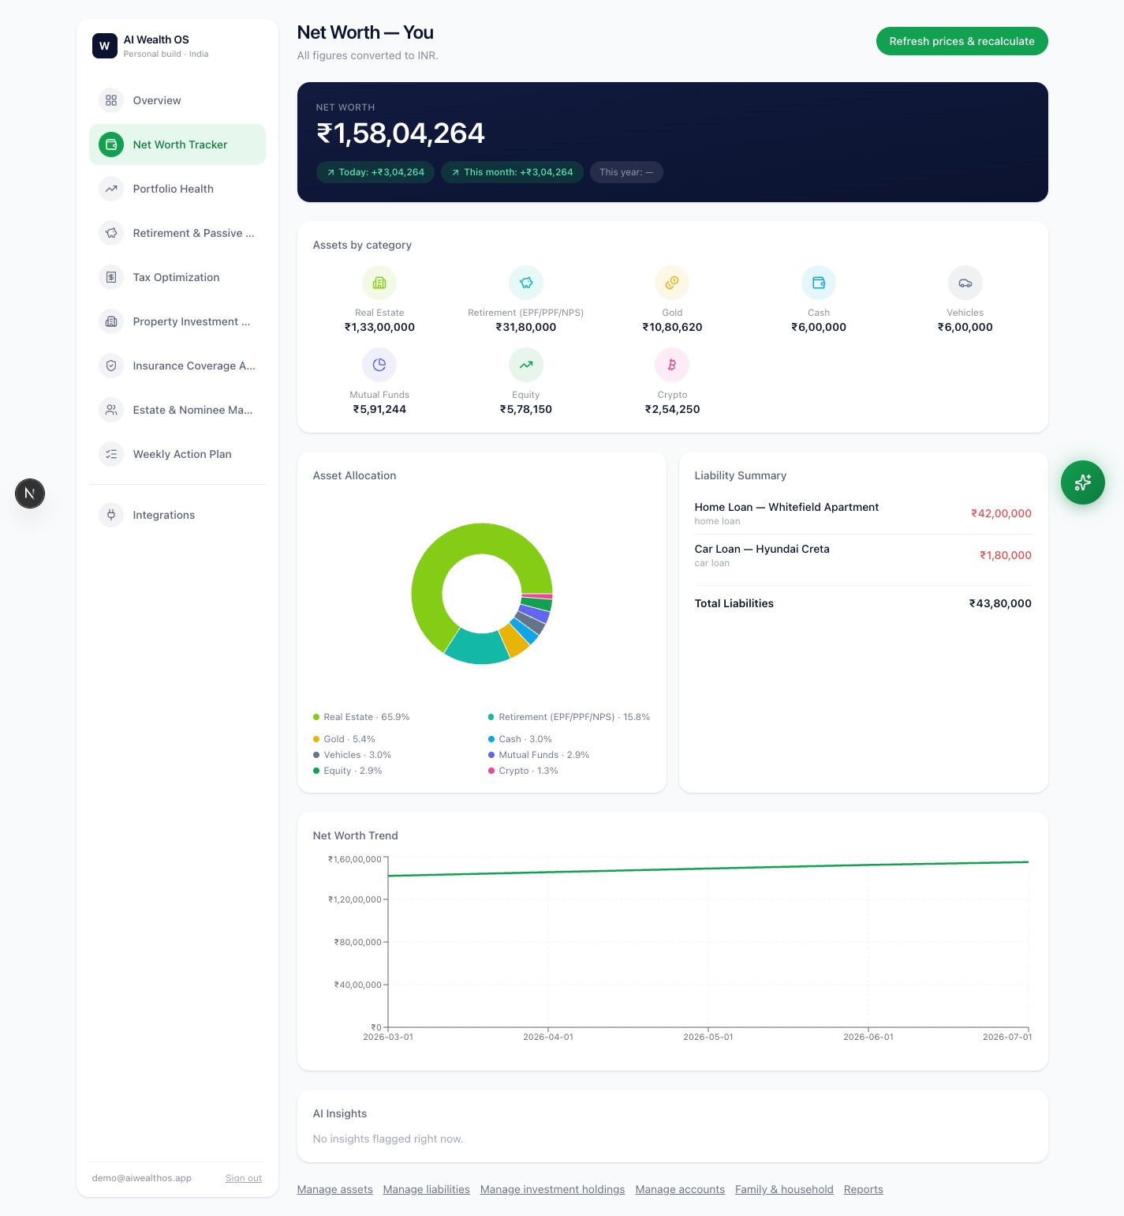
AI Wealth OS
A product example that organizes financial information
Observe the interface and workflow shown.
06
Notes:
Here is AI Wealth OS, our third product example. Again, pay attention to the information presented and the workflow visible in the recording. This is a product demonstration, not a recommendation to invest or a promise of returns. Across these examples, the useful lesson is to connect information with a clearly defined task. Now we will apply that idea to a narrow business problem, where we can write the rules and inspect the answer ourselves.

Slide 7
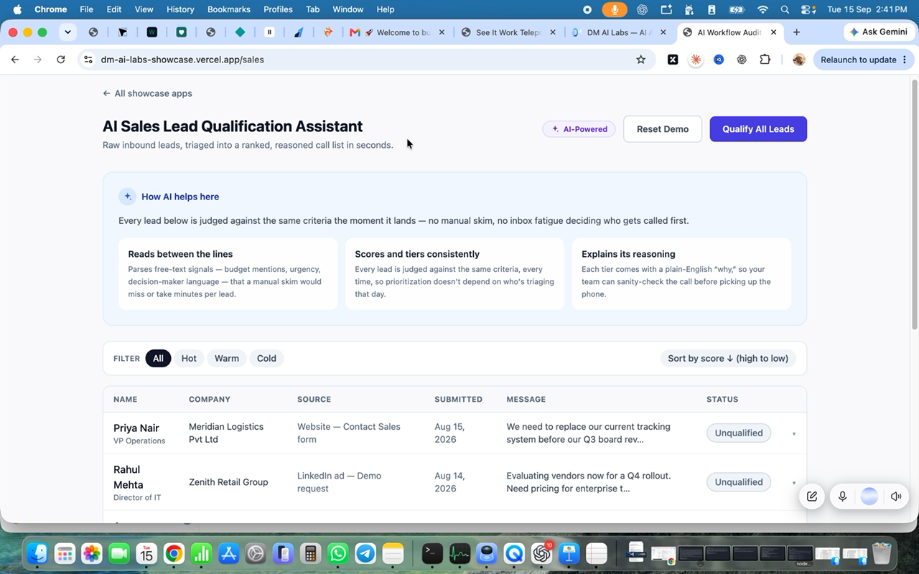
Sales lead qualification
Which enquiry deserves attention first?
Fictional leads with priority scores you can inspect
07
Notes:
The business question is which enquiry sales should act on first. Show the website example, then build a smaller fictional training version. The training scores use our supplied rules, which differ from the website demonstration. Source: https://dmailabs.ai/ and the approved sales recording.

Slide 8
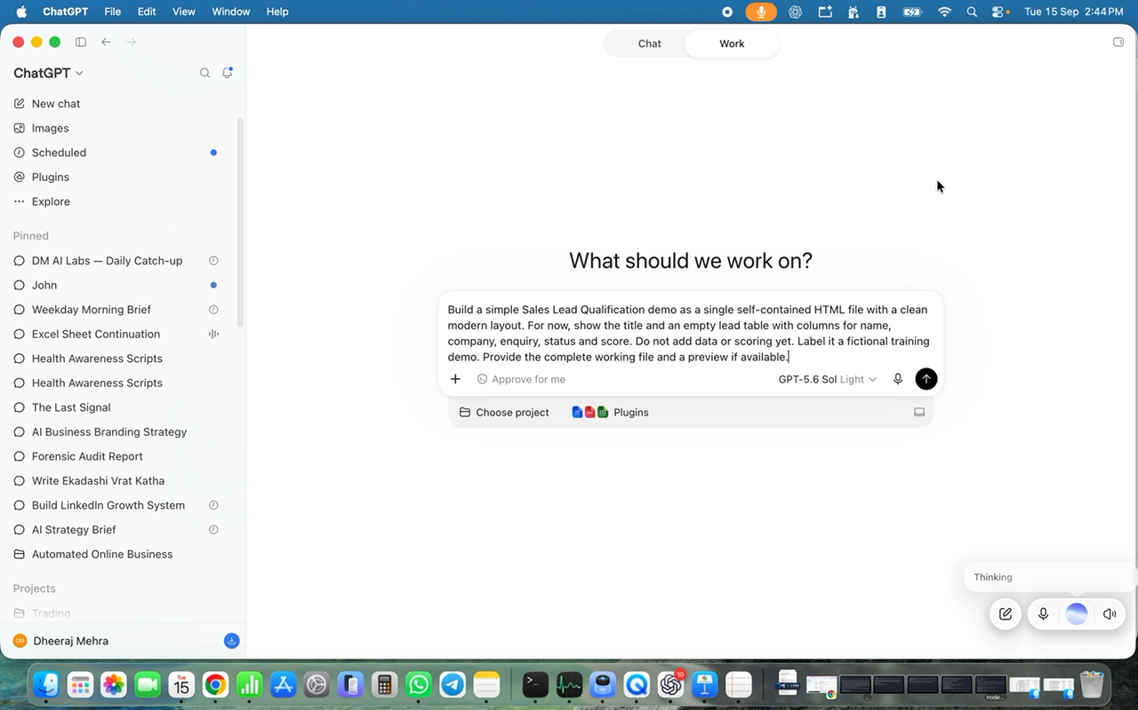
A page before decisions
An empty table, then six example leads
The first two prompts establish the page and sample data.
08
Notes:
The first prompt creates the page before adding data or scoring. A self-contained HTML file packages the page in a file the learner can open in a browser. The second prompt adds six fictional enquiries and an inactive qualification button. Inspect each stage before continuing.

Slide 9
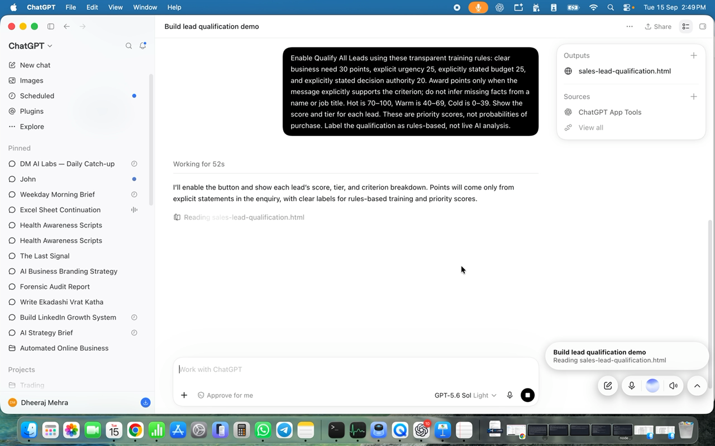
Our sample scoring rules
Need 30 Urgency 25
Budget 25 Authority 20
Hot 70–100 Warm 40–69 Cold 0–39
09
Notes:
Supply the sample rules explicitly: clear business need30, explicit urgency25, explicitly stated budget25, and explicitly stated decision authority20. Missing details earn zero. Hot70–100, Warm40–69, Cold0–39. These are priority points, not purchase probabilities. Learners can adapt rules to their own business.

Slide 10
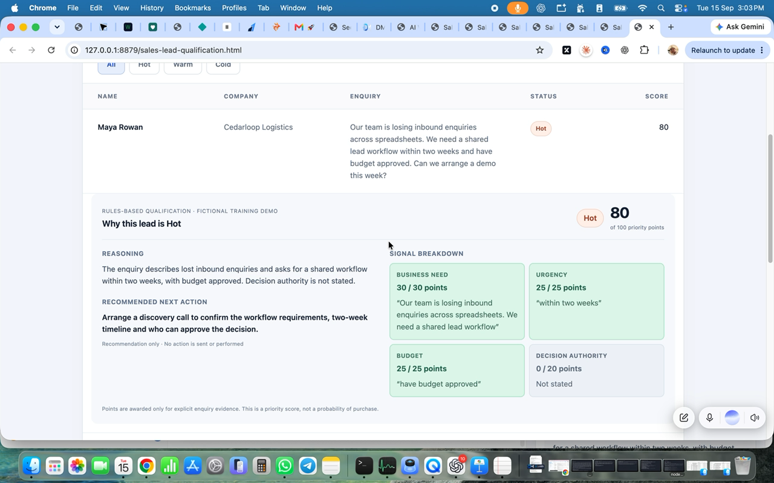
Every score has a reason
Points come from the enquiry
Missing facts earn zero. You inspect the evidence.
10
Notes:
Click a lead to inspect why it earned points. Check each criterion against the message. Do not infer authority from names or job titles. This training page uses rules-based qualification, not a live AI scoring connection.

Slide 11
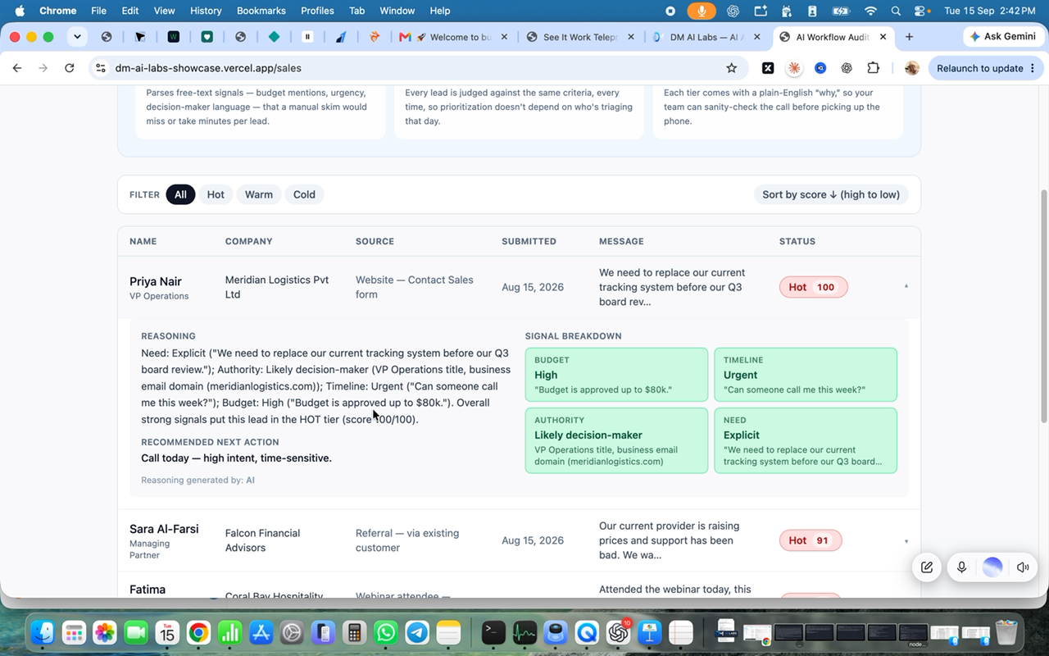
A clearer result
Reasoning, next action and signal breakdown
The presentation changes while the scoring stays the same.
11
Notes:
Prompts five and six improve readability and arrange reasoning plus a recommended next action beside four signal cards. Prompt seven uses an attached screenshot to guide the appearance. Preserve the existing data, rules and functions. A screenshot is a visual reference, not a guarantee of identical rendering.

Slide 12
The working sales demo
Sort, filter, inspect and reset
ChatGPT creates the code. The page applies the rules.
12
Notes:
Qualify all leads. Check descending score order, tier filters, expandable reasoning and reset. Maya Rowan in the recorded build earns80: need30, urgency25, budget25, authority0. An enquiry with no qualifying evidence earns0. Verify the actual results rather than trusting fluent explanations.

Slide 13
Your own small project
One task with rules you can explain
Test a normal case, missing information and an exception.
13
Notes:
Use the worksheet to define one task, the information it needs, and what a useful result would look like. Write the normal rules, exceptions and a stop condition. Prepare at least three examples: a normal case, missing information and a case where the tool should not continue. Keep your first project narrow. Save the working version and a simple guide so another person can understand how to use it. Measure the result against your own baseline rather than assuming a time saving.

Slide 14

The next stage
Build Your First AI Tool
A deeper course is in preparation.
14
Notes:
The next stage, Build Your First AI Tool, is in preparation. It is planned as sixteen short lessons with immediate sequential chapter access and four weekly Q&A sessions. Final project review includes a tool or reusable instructions, a simple guide, three tests and a two-minute demo. Availability, pricing and dates will be announced separately.

