Slide 1
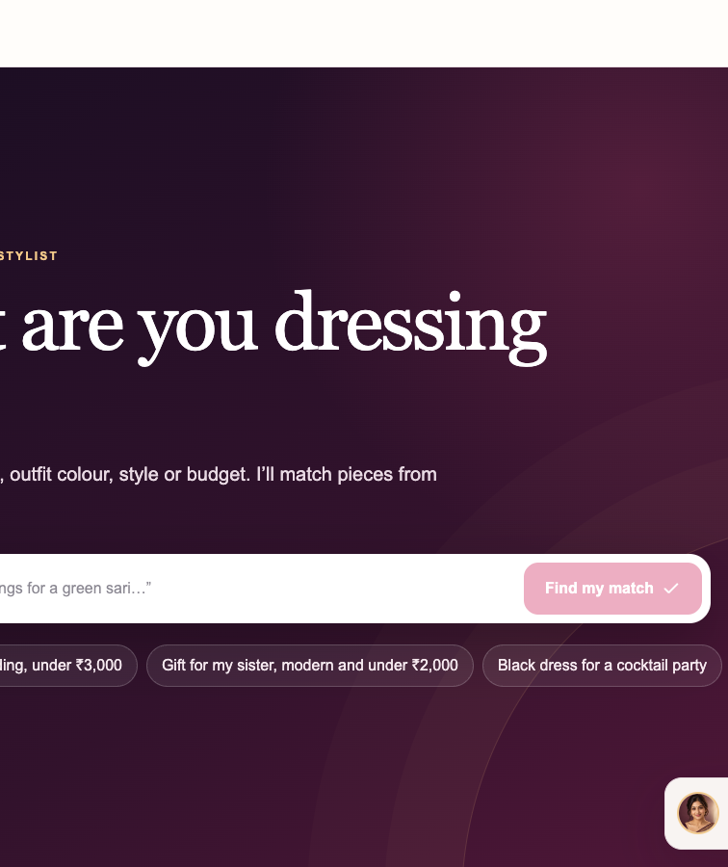
NAYARA
Conversational jewellery discovery
A working DM AI Labs showcase for ecommerce sales conversations
Fictional brand / Illustrative catalogue / Demo bag
DM AI Labs showcase / Nayara is fictional / 1/11
Notes:
Source: local working Nayara demo captured 27 Sep 2026. Public demo target: https://nayara-ai-jewellery-advisor.dheeraj-sunny.chatgpt.site/

Slide 2
The discovery gap
Filters work when shoppers already know the product language
“I’m wearing a bottle-green silk saree to an evening wedding and want something elegant under ₹4,000, but not too heavy.”
Jewellery often starts with an occasion, an outfit, a colour, a comfort preference, or a budget. Those needs arrive together and change after the shopper sees options.
DM AI Labs showcase / Nayara is fictional / 2/11
Notes:
The shopper request shown is the tested demo prompt.

Slide 3
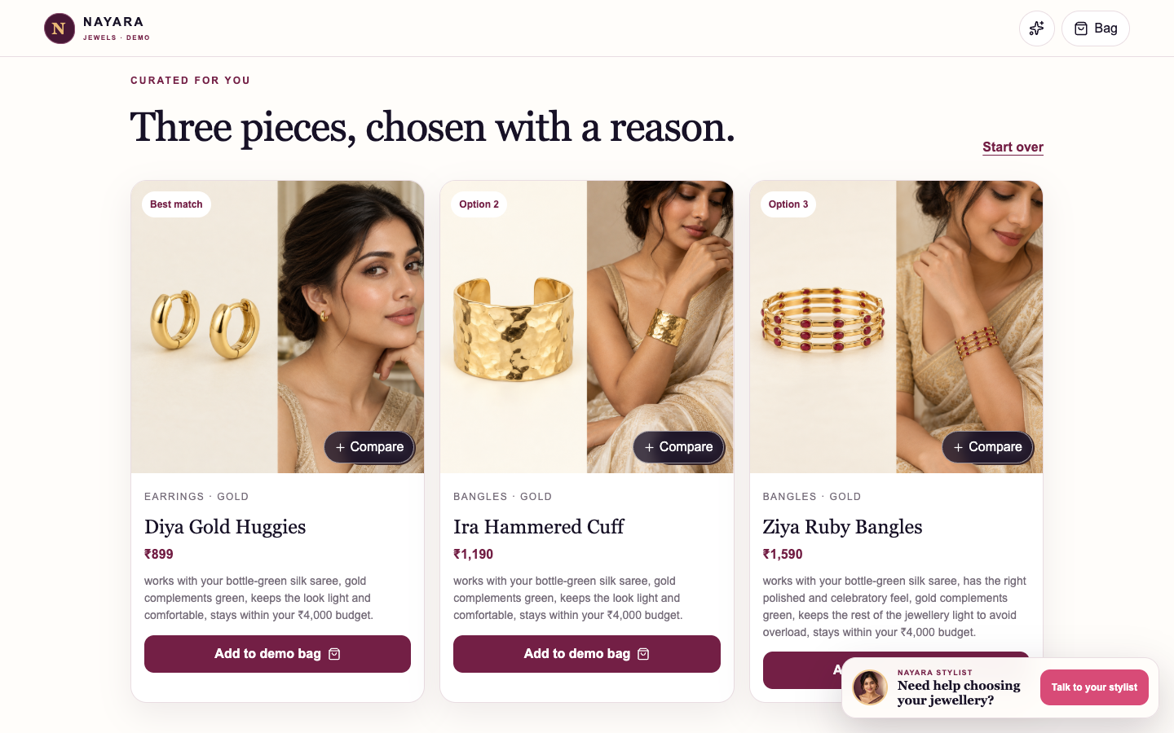
What Nayara demonstrates
One natural request
The shopper can combine occasion, outfit, colour, comfort, and budget.
Three visible choices
Each option comes from the illustrative catalogue with a grounded styling reason.
Spoken response
Mira summarises the result while the products stay visible.
DM AI Labs showcase / Nayara is fictional / 3/11
Notes:
Source: confirmed public demo screenshot. The catalogue contains 30 illustrative products.

Slide 4
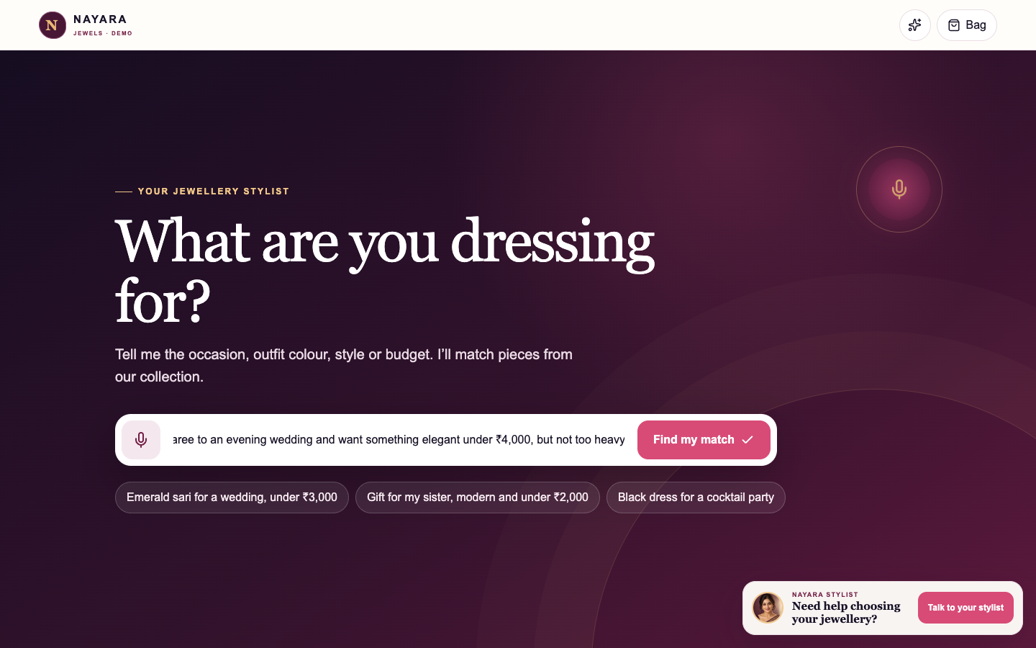
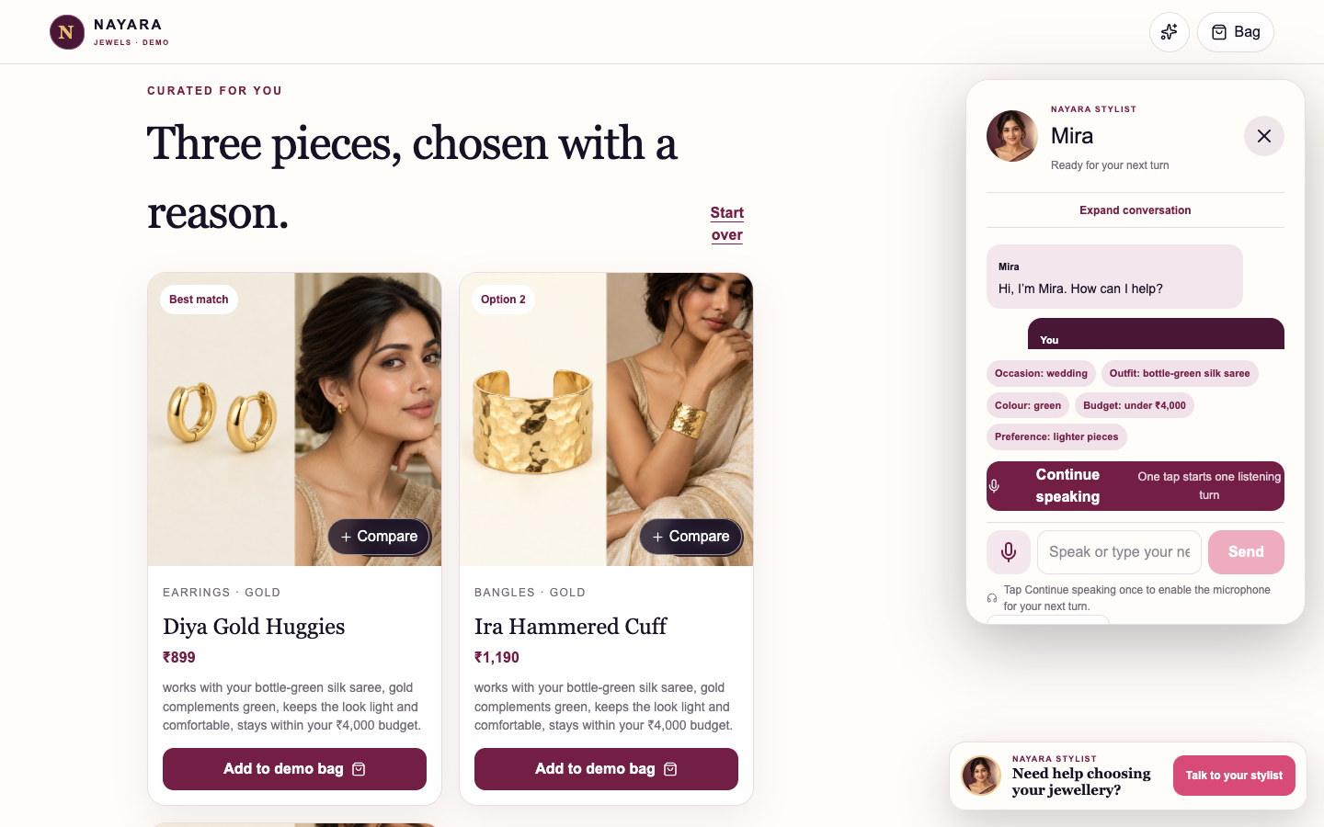
Live customer journey
1 Describe the whole need
2 Review products and continue the conversation
The demo can use voice input or typed turns. Typed turns provide the most stable capture while retaining Mira’s spoken replies.
DM AI Labs showcase / Nayara is fictional / 4/11
Notes:
Source: confirmed public demo screenshots. Voice input support depends on browser microphone permission and transcription reliability.

Slide 5
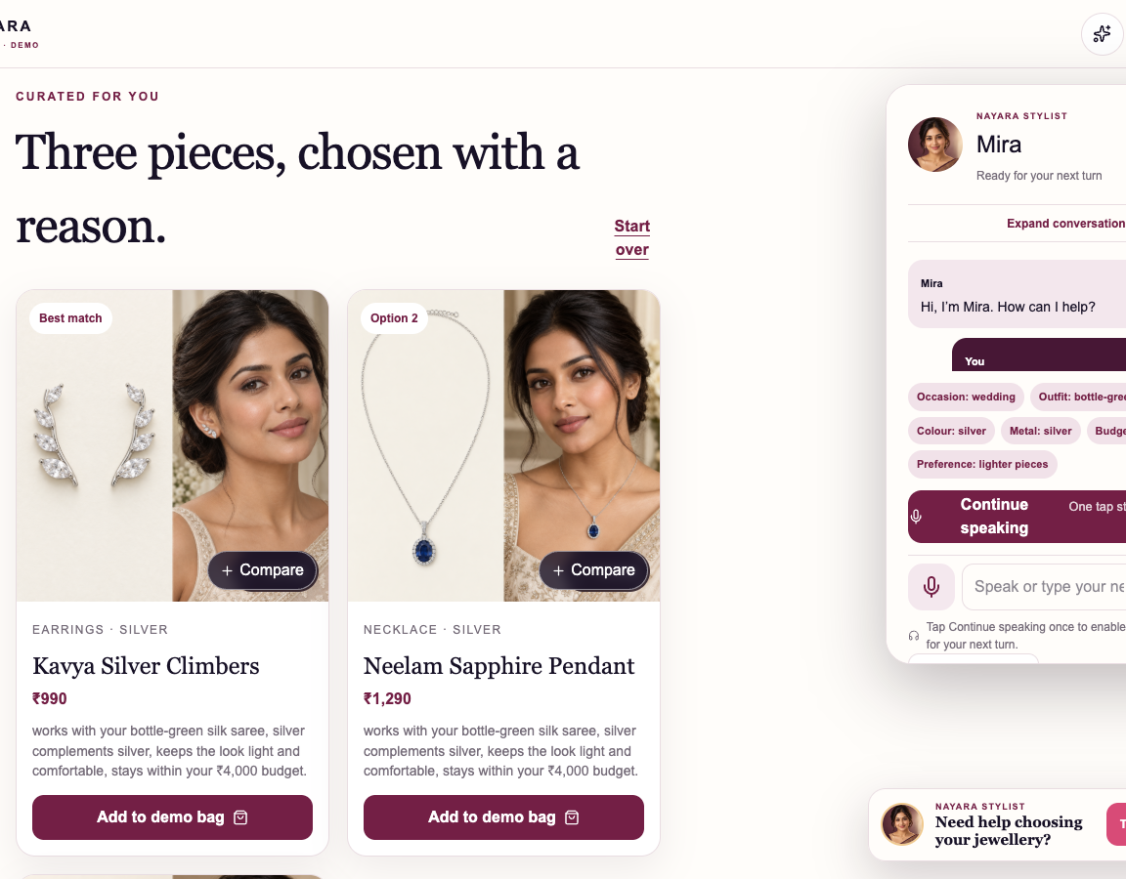
Conversation memory
Earlier context remains visible
The shopper changes the metal while keeping the wedding, outfit, comfort preference, and budget in the conversation.
Follow-up used
“Show me silver options instead, keeping the same occasion and budget.”
DM AI Labs showcase / Nayara is fictional / 5/11
Notes:
Source: local working demo screenshot.

Slide 6
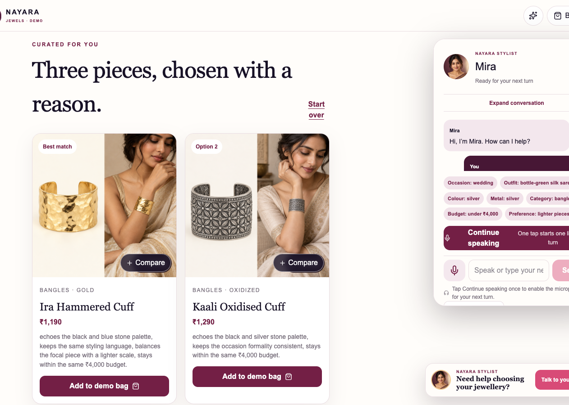
Coordinated selling
From one piece to a complete look
A matching-category request uses the current selection as the coordination anchor. The demo can carry forward the occasion and budget, then explain shared metal, stone, or styling cues.
Catalogue-grounded cross-sell
DM AI Labs showcase / Nayara is fictional / 6/11
Notes:
Source: local working demo screenshot. Recommendation explanations depend on recorded catalogue attributes.

Slide 7
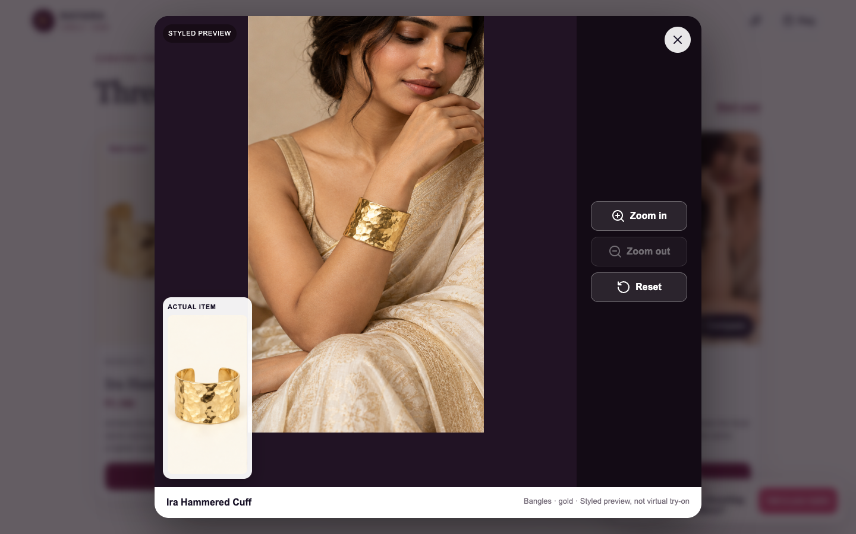
The visual layer
Styled model preview
A curated pairing helps the shopper imagine the piece with a complete look.
Product crop and zoom
A separate product view supports closer inspection.
These images illustrate styling. They do not provide virtual try-on.
DM AI Labs showcase / Nayara is fictional / 7/11
Notes:
Source: local working demo screenshot. Styled previews are curated pairings, not virtual try-on.

Slide 8
Lightweight pilot architecture
SHOPPER
CONVERSATION
CATALOGUE
EXPERIENCE
Voice or text request
Intent, context, safe actions
Selected feed and product attributes
Recommendations, visuals, demo actions
A pilot can begin with one category and a controlled action set, then expand only after review.
DM AI Labs showcase / Nayara is fictional / 8/11
Notes:
Conceptual pilot architecture. Exact systems and integrations depend on the brand’s ecommerce stack.

Slide 9
Pilot scope and success measures
Initial scope
Proposed measures
One catalogue segment
Two to four priority journeys
Controlled add-to-bag or handoff actions
Merchandising review before expansion
Recommendation relevance
Journey completion
Add-to-bag action completion
Response quality and latency
Safe fallback frequency
These are pilot measures, not results from the showcase.
DM AI Labs showcase / Nayara is fictional / 9/11
Notes:
No performance claims are made. Measures are proposed for a future pilot.

Slide 10
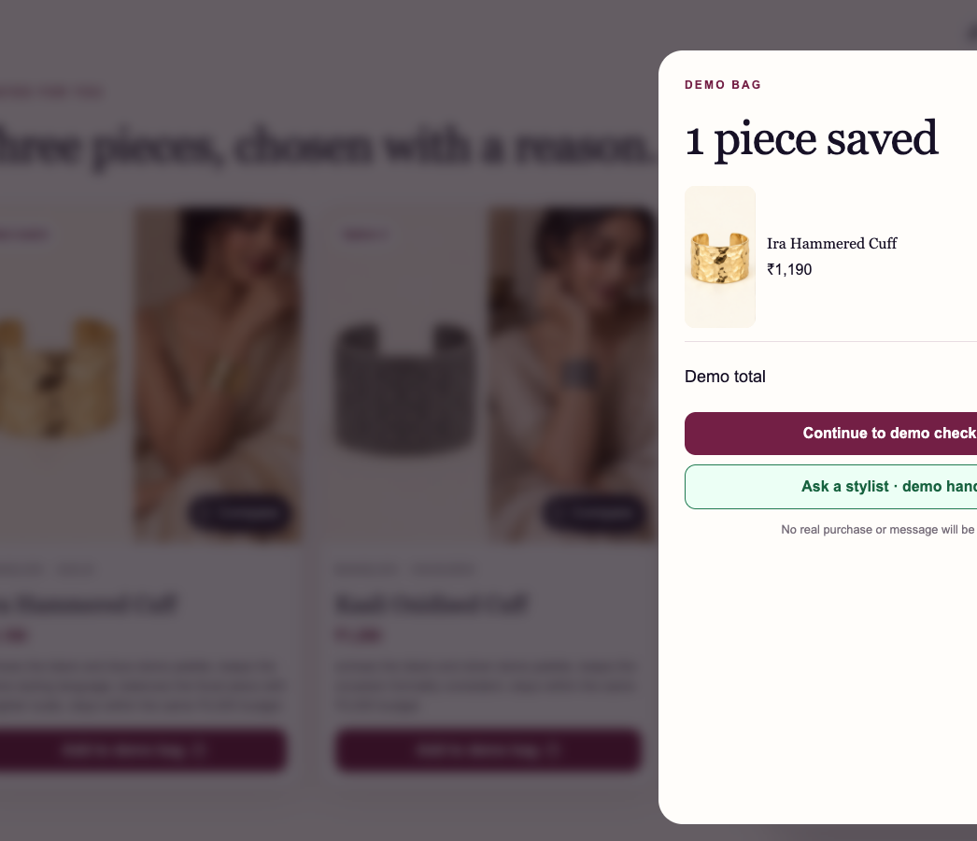
Where a pilot can fit
Occasion-led discovery
Fashion, jewellery, beauty, gifting, and other catalogue-led categories where shoppers describe intent before naming a product.
DM AI Labs paid pilot
Select a catalogue slice, agree on safe actions and review criteria, then test the journey with real merchandising input.
nayara-ai-jewellery-advisor.dheeraj-sunny.chatgpt.site
DM AI Labs showcase / Nayara is fictional / 10/11
Notes:
Public demo target URL. Confirm the public deployment before external publication.

Slide 11
Nayara proof links
Start with the hosted showcase, then choose the evidence you need
Hosted showcase page
Narrated demo video
https://dmailabs.ai/showcase/nayara-ai-jewellery-advisor/
https://dmailabs.ai/showcase/nayara-ai-jewellery-advisor/#walkthrough
Download the sales deck
Try the working demo
https://dmailabs.ai/showcase/nayara-ai-jewellery-advisor/nayara-sales-deck.pptx
https://nayara-ai-jewellery-advisor.dheeraj-sunny.chatgpt.site/
Fictional DM AI Labs showcase / Illustrative catalogue / Demo bag
DM AI Labs showcase / Nayara is fictional / 11/11
Notes:
Proof links: hosted showcase, embedded walkthrough, downloadable presentation, and working public demo.

